Slide 1
Brain Tumor Detection Using Deep Neural Networks
DNN LCA 1
Ananya Vaidya (1032232438, G2 batch)
Ananya Porwal (1032232297, G2 batch)

Slide 2
Problem Statement
Manual MRI analysis is slow and subjective.
Goal: Automatically classify brain MRI images as Tumor or No Tumor using CNN.

Slide 3
Objectives
Build CNN model
Preprocess MRI images
Train on real dataset
Evaluate accuracy
Predict tumor on new images

Slide 4
Dataset
Source: Kaggle Brain MRI Dataset
Classes: Tumor / No Tumor
Total Images: 253
Training Images: 202(78 No Tumor and 124 Tumor)
Testing Images: 51(20 No Tumor and 31 Tumor)
Split Ratio: 80% Train / 20% Test
Images loaded from local PC via Colab upload

Slide 5
Preprocessing
Resize images to 224×224
Normalize pixel values
Data augmentation (rotation, zoom, flip)
Convert folders into labeled data

Slide 6
CNN Architecture
Conv2D → MaxPooling
Conv2D → MaxPooling
Conv2D → MaxPooling
Flatten
Dense(128)
Dropout
Sigmoid Output

Slide 7
Training Setup
Optimizer: Adam
Loss: Binary Crossentropy
Epochs: 12
Batch Size: 16
Hardware: Google Colab GPU

Slide 8
Model Training
CNN learns features like edges, shapes and tumor patterns.
Weights updated using backpropagation and gradient descent.

Slide 9
Evaluation
Accuracy
Confusion Matrix
Classification Report
ROC Curve

Slide 10
Advantages
Automated detection
Reduces human error
Fast diagnosis
Scalable system

Slide 11
Limitations
Small dataset
Binary classification only
Needs more medical validation

Slide 12
Results
Final Test Accuracy ≈ 80–85%
Model successfully classifies MRI images
Single image prediction implemented

Slide 13
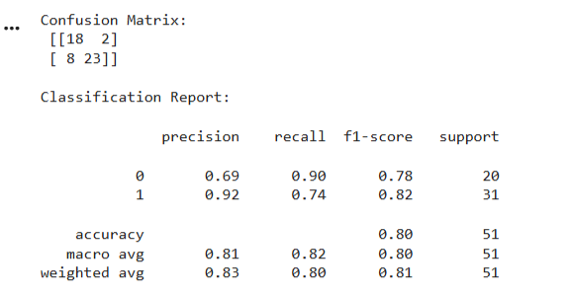
Outputs
Confusion Matrix
Classification Report

Slide 14
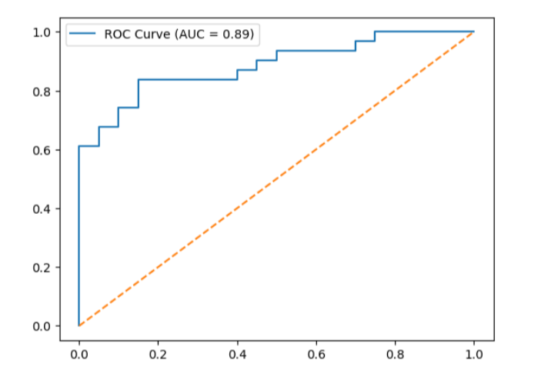
Outputs
ROC Curve Graph

Slide 15
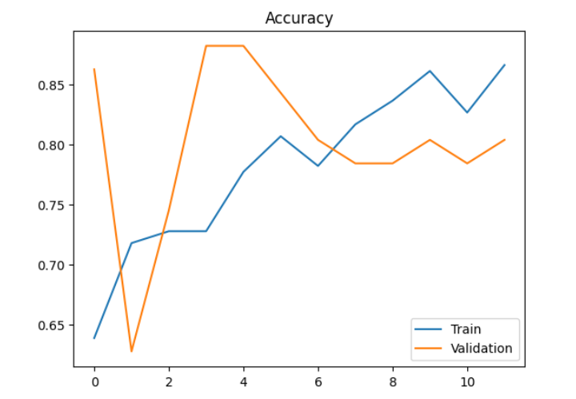
Outputs
Accuracy Graph

Slide 16
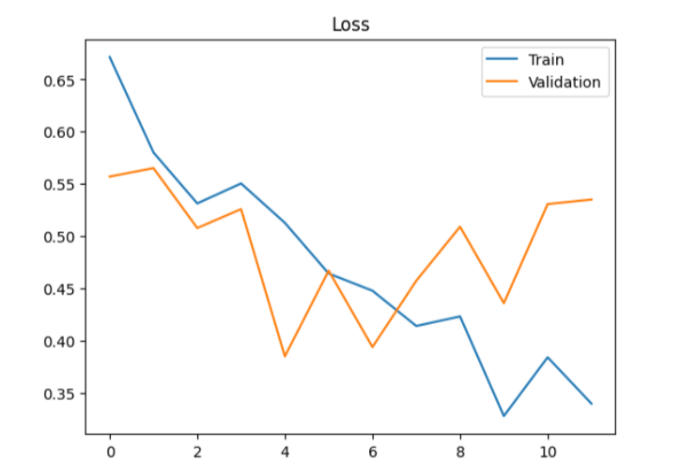
Outputs
Loss Graph

Slide 17

Prediction
Trained model predicts:
TUMOR or NO TUMOR
MRI image displayed along with result

Slide 18
Future Scope
Multi-class tumor detection
Larger datasets
Real hospital integration
Transfer learning

Slide 19
Conclusion
CNN successfully classifies brain MRI images.
Achieved ~85% accuracy.
Demonstrates potential of AI in medical imaging.

Slide 20
Thank You

